Slide 1



FAST National University of Computer and Emerging Sciences, Islamabad
Civics and Community Engagement

Slide 2
Google Classroom Code (CS-2025): pndnx5yr

Slide 3
DO’s and DON’T’s for Practical Work
DO’s
DON’T’S
Align Projects with Course Objectives
Collaborate Effectively
Respect Community Stakeholders
Parental Notification
Plan and Document
Engage Ethically
Reflect and Learn
Follow Guidelines
Organization Supervision
Avoid Superficial Engagement
Do Not Exploit or Harm
Don’t Work Without Approval
Avoid Personal Bias
Don’t Overcommit Resources
Don’t Miss Deadlines
Mandatory Attendance for Regular Classes and Weekly Practical Sessions

Slide 4
Maintain Documentation for the Course
Parental Notification Form (Students are expected to inform their parents about the course and keep them in loop while selecting their projects).
Approval Letter from the University (Obtain this letter during the initial weeks after/during finalizing your organization and submit it to the organization as proof of authorization.)
Acceptance Letter from the Organization (Submit this letter along with the project brief by the 4th week, on the organization's letterhead, duly signed and stamped by the supervisor/head.)
Meeting Record Form: (Submit this Meeting Record Form signed and stamped by the supervisor for each week of practical work and attach this form along with the final report at the end of the semester by the submission deadline. The form should be submitted in its original form (not a copy) to ensure authenticity.

Slide 5
Key takeaways
Understanding key terms (Civics, Community Engagement, Citizenship)
Civics and Citizenship in the light of Islamic/Pakistani Framework
Civic Duty vs. Responsibility
Community Need Assessment Tools

Slide 6




Civics
Civics refers to the rights and responsibilities of individuals in society, focusing on governance, law, and active participation in community life.
It is a bond between an individual and a state, characterized by mutual rights and obligations.

Slide 7
Civics in Islamic and Pakistani Context
Islamic Framework: Concepts of Shura (consultation), Adl (justice), and Maslaha (public welfare).
Pakistani Constitution: Article 38 promotes justice, equality, and social welfare aligned with Islamic principles.
Elimination of exploitation.
Provision of basic needs (food, clothing, shelter).
Institutionalized Zakat for wealth distribution.

Slide 8
Community Engagement
Community engagement involves taking a strategic approach to an organization’s community-based stakeholders.
This includes building relationships, developing communications, and managing interactions in order to achieve specific outcomes for the organization and the community itself (mutual outcomes).

Slide 9
Community and its Types
Community: Groups of people based on common geography (country, state, region, suburb, neighbourhood, etc.) or common interest (customs, values, religion, needs, etc.)
Residential Community: Focused on shared living locations.
Business Community: Professional networks sharing opportunities.
Volunteer Community: Groups working for greater good.
Religious Community: Based on shared faith and values.
Sport Community: Team players, fans, and families.
Support Community: Created around shared challenges.
Brand Community: Customers united by brand loyalty.

Slide 10
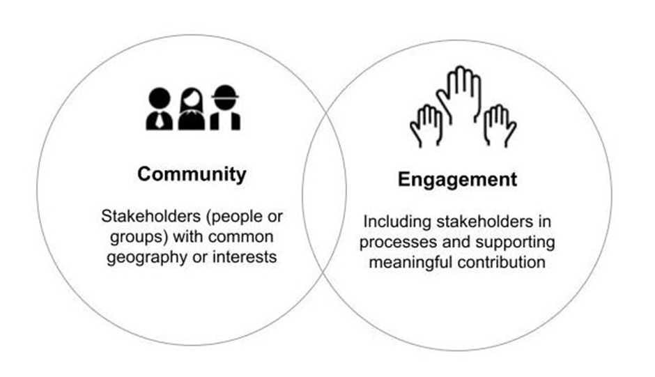
Engagement
The act of including stakeholders in activities and communications and allowing them to contribute in a meaningful way.

Slide 11
Islamic Perspective regarding Community Engagement
Islamic emphasis on social welfare and justice.
The Quran and Hadith emphasize helping neighbors, supporting the needy, and working for the collective good. The Prophet Muhammad (PBUH) said: "The best of people are those who bring the most benefit to others." (Hadith, Musnad Ahmad)

Slide 12





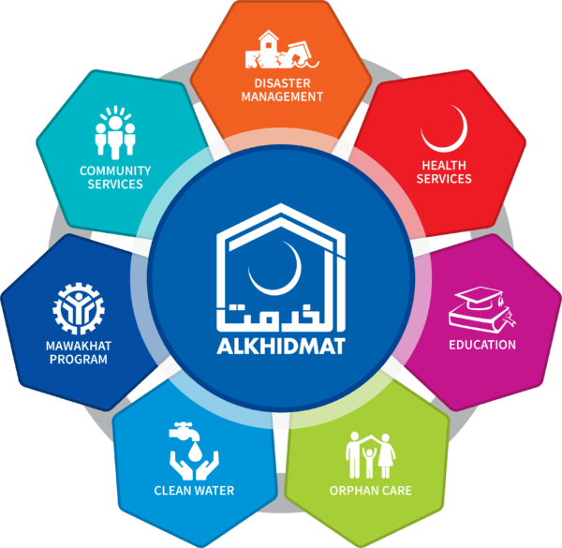
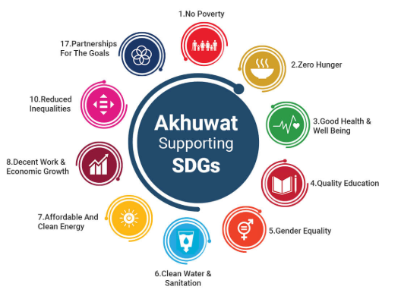
Community Engagement in Pakistan

Slide 13
Citizenship
Citizenship refers to the legal and social relationship between an individual and a state or nation. It encompasses certain rights, responsibilities, and privileges granted by the state to the individual, and in return, the individual owes allegiance and fulfills duties toward the state. Citizenship is often tied to a sense of belonging and cultural or national identity.
Islamic Concept: Ummah emphasizes shared faith, justice, and welfare.
Pakistan: Citizenship Act of 1951 defines legal and moral duties.
Voting is an Islamic and civic responsibility.
Paying Zakat and taxes ensures economic and social welfare.

Slide 14
Civic Duty (Mandatory)
A civic duty is a legal obligation or mandatory requirement for citizens to follow, enforced by law.
Civic duties are vital because they ensure the orderly functioning of society and uphold the rule of law.
Failure to fulfill these duties can lead to legal penalties, disrupting the stability and integrity of the social and governmental systems.
Examples: Obeying the law to maintain social order, paying taxes for public services and infrastructure, and Jury duty in democratic nations for judicial participation.

Slide 15
Civic Responsibility (Voluntary)
A civic responsibility is a voluntary act or moral obligation that benefits the community and promotes the common good. It is not legally enforced but is essential for a healthy society.
Neglecting these responsibilities may not have immediate legal consequences but can lead to societal stagnation and a lack of communal harmony and growth.
Examples: Voting to elect just leaders, volunteering for societal growth, and staying informed about policies and societal changes.

Slide 16
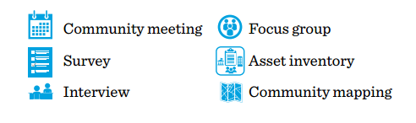
Tools of Community Need Assessment

Slide 17
Community Meeting (Town Hall or Public Forum)
A community meeting is an informal public gathering that brings together community members to discuss issues, voice concerns, and express preferences for community priorities.
Ideally, a respected local individual or community organization representative serves as the facilitator (having clear goal), , especially in cases of cultural or language barriers.

Slide 18
Community Meeting (Town Hall or Public Forum) Advantages and Challenges
Advantages
Advantages Encourages diverse perspectives and collaboration.
Engages large groups and identifies community leaders.
Highlights key issues and explores solutions.
Challenges
Maintaining a comfortable, focused environment.
Social constraints (ender disparities, power dynamics,
cultural norms) and dominance by vocal participants.

Slide 19
Community Meeting (Town Hall or Public Forum) Addressing Challenges
Tips to Address Challenges
Involve quieter participants and monitor group dynamics.
Use positive body language and enforce respectful communication.
Summarize discussions to stay on topic.
Following Up After a Community Meeting
Thank participants for their time and feedback.
Share key insights and outline next steps or action plans.
Involve key individuals to assist with identified projects or initiatives.

Slide 20
Survey
A survey is a widely used tool to gather information and opinions. In community assessments, surveys help evaluate perceived strengths, weaknesses, needs, and assets.
They can target the general population or specific groups and are conducted via email, phone, or in person.

Slide 21
Survey Advantages and Challenges
Advantages
Remote, repeatable, cost-effective, and anonymous, encouraging honest responses.
Challenges
Challenges with respondent access, low response rates, bias, and limited effectiveness for illiterate populations or areas with poor internet.

Slide 22
Interview
An interview is a one-on-one conversation between a facilitator and a community stakeholder.
It provides in-depth insights into the respondent’s ideas and feelings. Unlike surveys, interviews allow for follow-up questions, and unlike group assessments, they offer a focused setting, encouraging the respondent to share personal opinions freely.

Slide 23
Interview Advantages and Challenges
Advantages
Enable in-depth, flexible conversations, encourage open responses, and are effective for qualitative data, even with illiterate populations.
Challenges
Time-intensive, limited to one respondent at a time, require skilled facilitators, and may face difficulty in finding participants.

Slide 24
Focus Group
A focus group is a guided discussion with 6-12 diverse participants to explore opinions on community issues.
It promotes collaboration, requires skilled facilitation, and should be held in a comfortable, private setting.
Note: Consider cultural and community factors, such as gender and age, when selecting participants.

Slide 25
Focus Group Advantages and Challenges
Advantages
Focus groups are quick to organize, leverage group dynamics for deeper insights, are useful for qualitative topics, and work well with illiterate populations.
Challenges
Focus groups may be biased, dominated by a few participants, time-consuming to analyze, and not provide individual insights. Results might not represent the whole community, requiring more groups.

Slide 26
Asset Inventory
An asset inventory identifies valuable resources in a community, such as people, institutions, services, and physical spaces. Participants document and analyze these assets, which helps explore how they can work together to drive positive change.

Slide 27
Asset Inventory Advantages and Challenges
Advantages
Maximizes resources, fosters inclusive networks, identifies community interests, and can be reused.
Challenges
Time-consuming analysis, difficulty in organizing assets, and may overlook non-physical assets.

Slide 28
Community Mapping
Community mapping reveals diverse perspectives about a community, requiring minimal resources and time.
Participants create maps marking important places and discuss how they use community resources and barriers to access.
This activity helps identify resource usage, perceptions of importance, and ideas for improvement.

Slide 29
Community Mapping What to Map
Places of residence and importance (markets, schools, clinics, etc.)
Frequency of visits (daily, weekly, monthly, or yearly)
Places enjoyed or disliked (with different colored markers)
Desired additions to the community (indicated by sticky notes or paper squares)

Slide 30
Community Mapping Advantages and Challenges
Advantages
Engaging and lively, encourages community improvement discussions, and can involve multiple stakeholder groups.
Challenges
Difficult data analysis due to visual format, and drawing conclusions may require further assessments.

Slide 31
References
Dahl, R. A. (2000). On Democracy. Yale University Press. New Haven & London.
International IDEA. (2021). Global State of Democracy Report. Available at: https://www.idea.int/gsod
OECD. (2020). Tax Policy Reforms in OECD Countries. Available at: https://www.oecd.org/tax/tax-policy-reforms-2020.htm
Smith, J. (2018). Civic Engagement and the Role of the Citizen in Judicial Processes. Journal of Democracy, 29(3), 45-57.
United Nations. (2019). Strengthening the Rule of Law and Promoting Human Rights. Available at: https://www.un.org/ruleoflaw/
Volunteer Canada. (2020). The Value of Volunteering. Available at: https://volunteer.ca/index.php?MenuItemID=417

